Slide 1
Combat Sports
Matthew Vastarelli

Slide 2
Overview
Generate relevant statistics
Compound existing statics
Discover new insights
Generlizabe

Slide 3
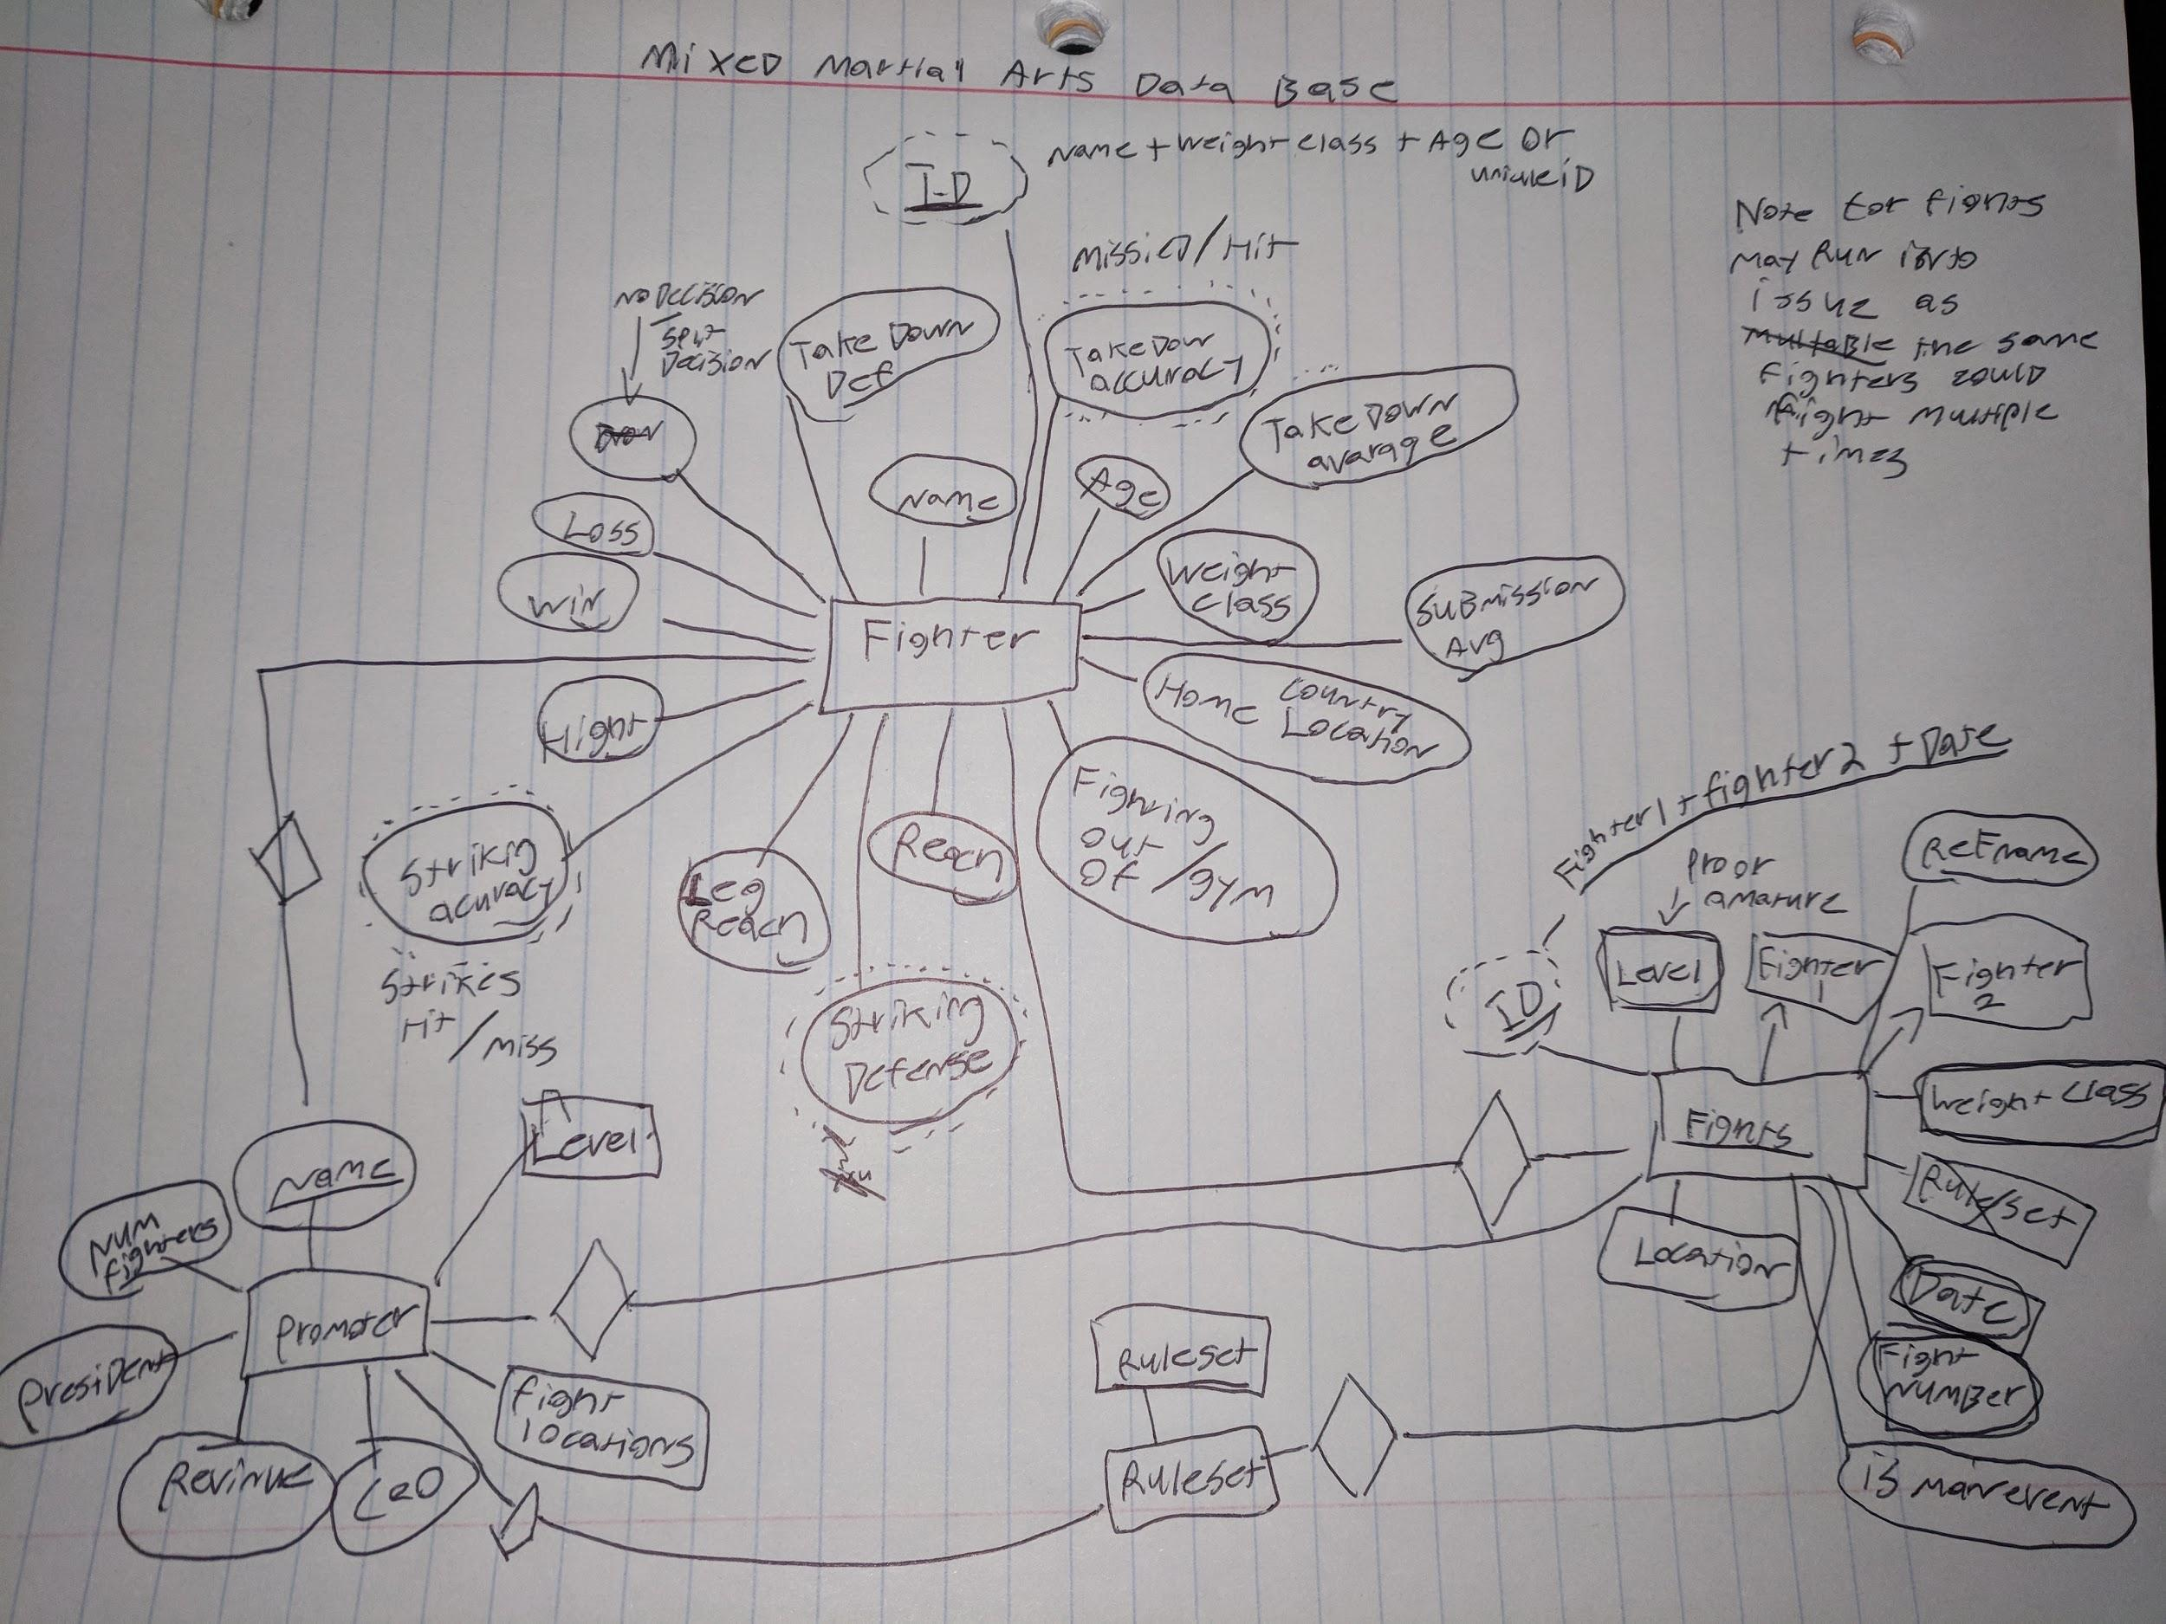
First ER Diagram

Slide 4
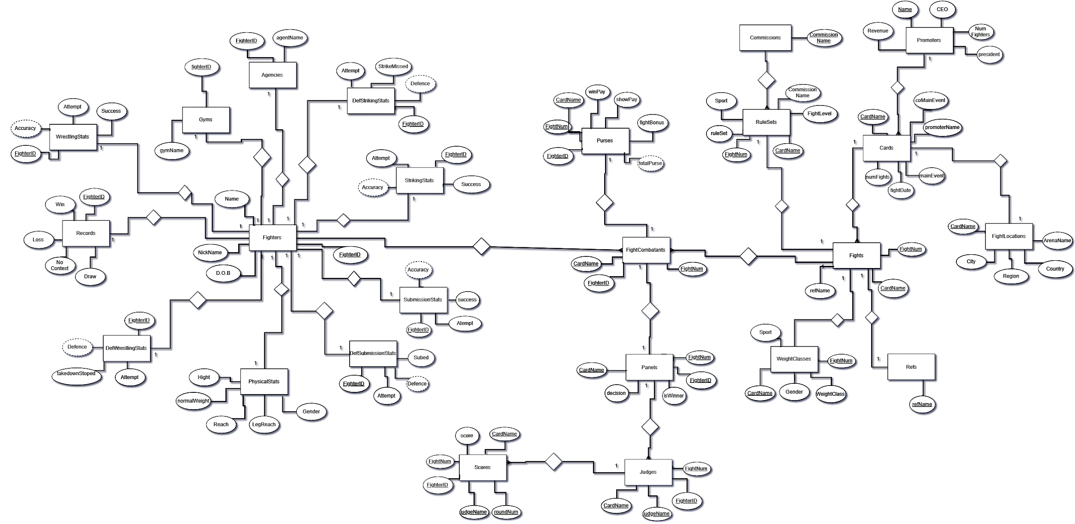
Final ER diagram

